Slide 1
IEEE 802.11 CSMA/CA DCF
CSE 6590
Fall 2009

Slide 2
MAC Requirements
To avoid interference among simultaneous transmissions
  But enable as many non-interfering transmission as possible
  Maintain fairness among transmissions
No centralized coordinators: fully distributed operations
No clock synchronization: asynchronous operations

Slide 3
Carrier Sensing
Problems
  Hidden terminal problem
  Exposed terminal problem
Sensing range > Transmission range
Contention matters only at the receiver’s end

Slide 4
Hidden Terminal Problem
B
A
X
No carrier ≠ OK to transmit

Slide 5
Exposed Terminal Problem
B
A
Y
X
Presence of carrier ≠ holds off transmission

Slide 6
Existing Work
MACA [Karn 1990]
  Proposes to solve the hidden terminal problem by RTS/CTS dialog
MACAW [Bharghanvan 1994]
  Increasing reliability by RTS/CTS/DATA/ACK dialog
IEEE 802.11
  Distributed Coordination Function (DCF)
  Also use RTS/CTS/DATA/ACK dialog

Slide 7

RTS/CTS dialog (1)
Defer
RTS
Any node hearing this RTS will defer medium access

Slide 8
RTS/CTS dialog (2)
Defer
Defer
RTS
CTS
Any node hearing this CTS will defer medium access

Slide 9
RTS/CTS/DATA/ACK dialog
Defer
Defer
Data
ACK

Slide 10
IEEE 802.11 DCF
Uses RTS/CTS exchange to avoid hidden terminal problem
  Any node overhearing a CTS cannot transmit for the duration of the transfer.
  Any node overhearing an RTS cannot transmit for the duration of the transfer (to avoid collision with ACK)
Uses ACK to achieve reliability
CSMA/CA
  Contention-based random access
  Collision detection not possible while transmitting

Slide 11
IEEE 802.11 DCF (cont.)
Carrier sense in 802.11
  Physical carrier sense
  Virtual carrier sense using Network Allocation Vector (NAV)
    RTS/CTS specify duration of subsequent DATA/ACK
    NAV is updated based on overheard RTS/CTS
Collision avoidance
  Nodes stay silent when carrier sensed busy (physical/virtual)
  Backoff intervals are used to reduce collision probability

Slide 12
Backoff Interval
When channel is busy, choose a backoff interval in the range [0, cw].
Count down the backoff interval when medium becomes idle.
Count down is suspended if medium becomes busy again.
When backoff interval reaches 0, transmit RTS.
Binary exponential backoff in 802.11 DCF:
  When a node fails to receive CTS, cw is doubled up (up to an upper bound).
  When a data transfer completes successfully, cw is reset to cw_{min}.

Slide 13
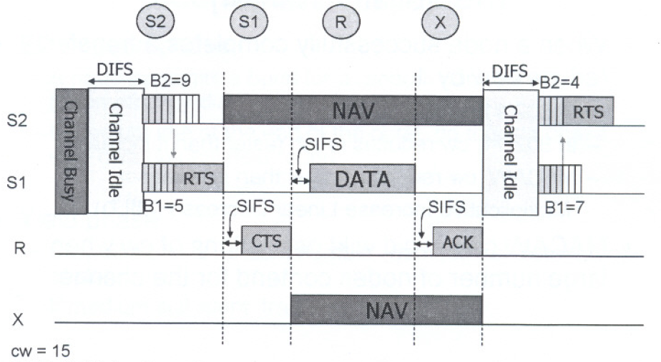
IEEE 802.11 CSMA/CA – Example
DIFS: DCF inter-frame space SISF: short inter-frame space

Slide 14
Disadvantages of IEEE 802.11 DCF
High power consumption
Hidden terminal problem not totally solved (e.g., collision of RTS)
Exposed terminal problem not solved
Fairness problem among different transmitting nodes
Only providing best-effort service

Slide 15
Detailed 802.11 DCF

Slide 16
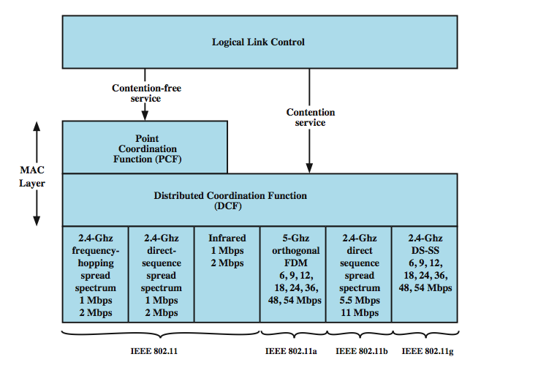
Media Access Control
Notes:
The 802.11 working group considered two types of proposals for a MAC algorithm: distributed access protocols, which, like Ethernet, distribute the decision to transmit over all the nodes using a carrier sense mechanism; and centralized access protocols, which involve regulation of transmission by a centralized decision maker. A distributed access protocol makes sense for an ad hoc network of peer workstations (typically an IBSS) and may also be attractive in other wireless LAN configurations that consist primarily of bursty traffic. A centralized access protocol is natural for configurations in which a number of wireless stations are interconnected with each other and some sort of base station that attaches to a backbone wired LAN; it is especially useful if some of the data is time sensitive or high priority. The end result for 802.11 is a MAC algorithm called DFWMAC (distributed foundation wireless MAC) that provides a distributed access control mechanism with an optional centralized control built on top of that.
Stallings DCC8e Figure 17.5 illustrates the architecture. The lower sublayer of the MAC layer is the distributed coordination function (DCF). DCF uses a contention algorithm to provide access to all traffic. Ordinary asynchronous traffic directly uses DCF. The point coordination function (PCF) is a centralized MAC algorithm used to provide contention-free service. PCF is built on top of DCF and exploits features of DCF to assure access for its users.

Slide 17
Distributed Coordination Function
DCF sublayer uses CSMA
  if station has frame to send it listens to medium
  if medium idle, station may transmit
  else waits until current transmission complete
No collision detection since on wireless network
DCF includes delays that act as a priority scheme
Notes:
The DCF sublayer makes use of a simple CSMA (carrier sense multiple access) algorithm. If a station has a MAC frame to transmit, it listens to the medium. If the medium is idle, the station may transmit; otherwise the station must wait until the current transmission is complete before transmitting. The DCF does not include a collision detection function (i.e., CSMA/CD) because collision detection is not practical on a wireless network. The dynamic range of the signals on the medium is very large, so that a transmitting station cannot effectively distinguish incoming weak signals from noise and the effects of its own transmission. To ensure the smooth and fair functioning of this algorithm, DCF includes a set of delays that amounts to a priority scheme. Let us start by considering a single delay known as an interframe space (IFS). In fact, there are three different IFS values, but the algorithm is best explained by initially ignoring this detail.

Slide 18
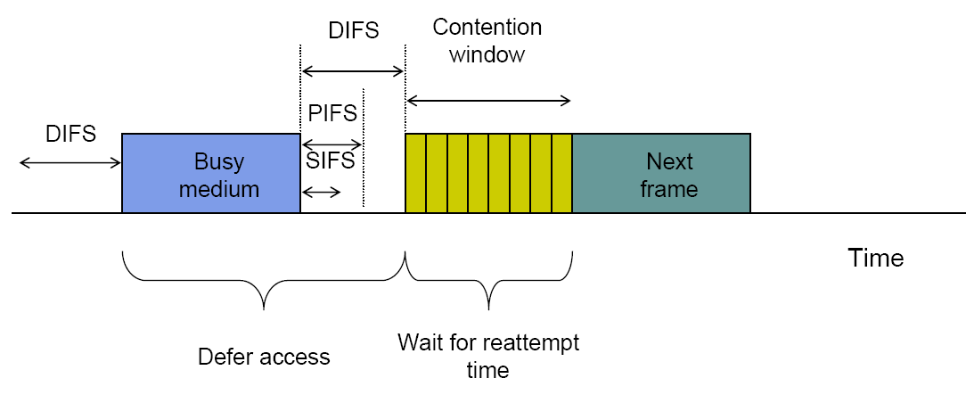
Basic CSMA/CA operations
Fig. 6.69 (Leon-Garcia)

Slide 19
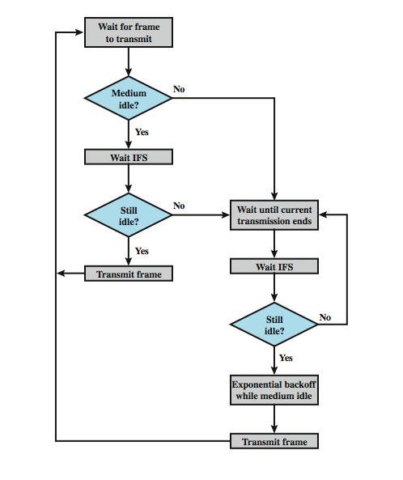
IEEE 802.11
Medium
Access
Control
Logic
Notes:
Using an IFS, the rules for CSMA access are as follows (Stallings DCC8e Figure 17.6):
1. A station with a frame to transmit senses the medium. If the medium is idle, it waits to see if the medium remains idle for a time equal to IFS. If so, the station may transmit immediately.
2. If the medium is busy (either because the station initially finds the medium busy or because the medium becomes busy during the IFS idle time), the station defers transmission and continues to monitor the medium until the current transmission is over.
3. Once the current transmission is over, the station delays another IFS. If the medium remains idle for this period, then the station backs off a random amount of time and again senses the medium. If the medium is still idle, the station may transmit. During the backoff time, if the medium becomes busy, the backoff timer is halted and resumes when the medium becomes idle.
4.If the transmission is unsuccessful, which is determined by the absence of an acknowledgement, then it is assumed that a collision has occurred.
To ensure that backoff maintains stability, binary exponential backoff, described in Chapter 16, is used. Binary exponential backoff provides a means of handling a heavy load. Repeated failed attempts to transmit result in longer and longer backoff times, which helps to smooth out the load. Without such a backoff, the following situation could occur: Two or more stations attempt to transmit at the same time, causing a collision. These stations then immediately attempt to retransmit, causing a new collision.

Slide 20
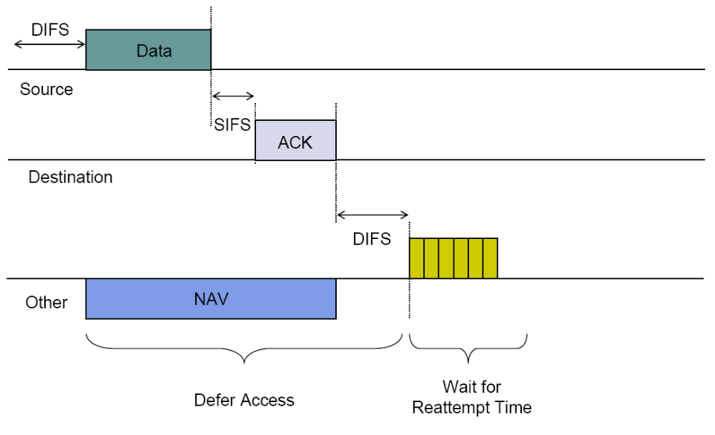
Transmission without RTS/CTS
Fig. 6.71 (Leon-Garcia)

Slide 21
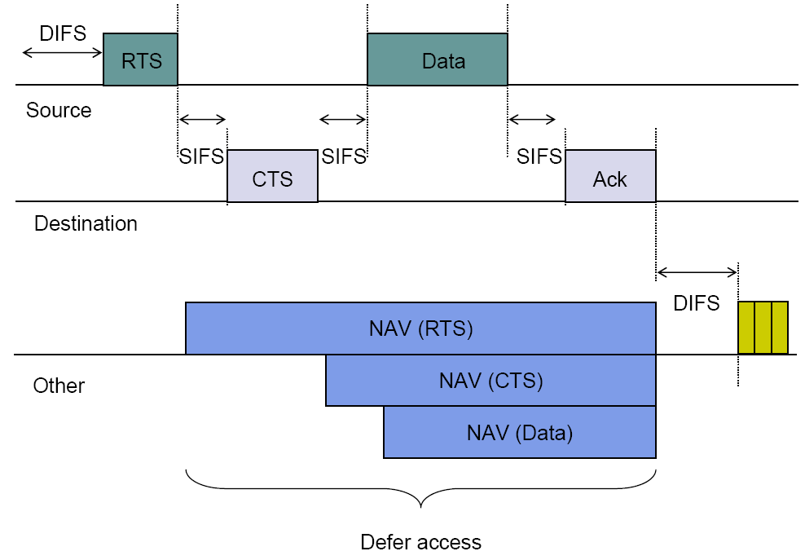
Transmission with RTS/CTS
Fig. 6.72 (Leon-Garcia)

Slide 22
Priority IFS Values
SIFS (short IFS)
  for all immediate response actions (see later)
PIFS (point coordination function IFS)
  used by the centralized controller in PCF scheme when issuing polls
DIFS (distributed coordination function IFS)
  used as minimum delay for asynchronous frames contending for access
Notes:
The preceding scheme is refined for DCF to provide priority-based access by the simple expedient of using three values for IFS:
• SIFS (short IFS): The shortest IFS, used for all immediate response actions, as explained in the following discussion
• PIFS (point coordination function IFS): A midlength IFS, used by the centralized controller in the PCF scheme when issuing polls
• DIFS (distributed coordination function IFS): The longest IFS, used as a minimum delay for asynchronous frames contending for access

Slide 23
SIFS Use
SIFS gives highest priority
  over stations waiting PIFS or DIFS time
SIFS used in following circumstances:
  Acknowledgment (ACK)
    station responds with ACK after waiting SIFS gap
    for efficient collision detect & multi-frame transmission
  Clear to Send (CTS)
    station ensures data frame gets through by issuing RTS
    and waits for CTS response from destination
  Poll response
    see Point coordination Function (PCF) discussion next
Notes:
Consider first the SIFS. Any station using SIFS to determine transmission opportunity has, in effect, the highest priority, because it will always gain access in preference to a station waiting an amount of time equal to PIFS or DIFS. The SIFS is used in the following circumstances:
• Acknowledgment (ACK): When a station receives a frame addressed only to itself (not multicast or broadcast), it responds with an ACK frame after waiting only for an SIFS gap. This has two desirable effects. First, because collision detection is not used, the likelihood of collisions is greater than with CSMA/CD, and the MAC-level ACK provides for efficient collision recovery. Second, the SIFS can be used to provide efficient delivery of an LLC protocol data unit (PDU) that requires multiple MAC frames. In this case, the following scenario occurs. A station with a multiframe LLC PDU to transmit sends out the MAC frames one at a time. Each frame is acknowledged by the recipient after SIFS. When the source receives an ACK, it immediately (after SIFS) sends the next frame in the sequence. The result is that once a station has contended for the channel, it will maintain control of the channel until it has sent all of the fragments of an LLC PDU.
• Clear to Send (CTS): A station can ensure that its data frame will get through by first issuing a small Request to Send (RTS) frame. The station to which this frame is addressed should immediately respond with a CTS frame if it is ready to receive. All other stations receive the RTS and defer using the medium.
• Poll response: This is explained in the following discussion of PCF.

Slide 24
PIFS and DIFS Use
PIFS used by centralized controller
  for issuing polls
  has precedence over normal contention traffic
  but not SIFS
DIFS used for all ordinary asynchronous traffic
Notes:
The next longest IFS interval is the PIFS. This is used by the centralized controller in issuing polls and takes precedence over normal contention traffic. However, those frames transmitted using SIFS have precedence over a PCF poll.
Finally, the DIFS interval is used for all ordinary asynchronous traffic.

Slide 25
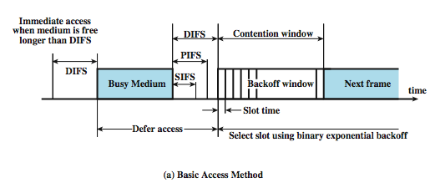
IEEE 802.11 MAC Timing
Basic Access Method
Notes:
Stallings DCC8e Figure 17.7a illustrates the use of these time values.

Slide 26
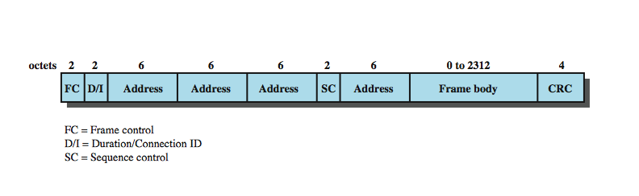
IEEE 802.11 MAC Frame Format
Notes:
Stallings DCC8e Figure 17.8 shows the 802.11 frame format. This general format is used for all data and control frames, but not all fields are used in all contexts. The fields are:
• Frame Control: Indicates the type of frame (control, management, or data) and provides control information. Control information includes whether the frame is to or from a DS, fragmentation information, and privacy information.
• Duration/Connection ID: If used as a duration field, indicates the time (in microseconds) the channel will be allocated for successful transmission of a MAC frame. In some control frames, this field contains an association, or connection, identifier.
• Addresses: The number and meaning of the 48-bit address fields depend on context. The transmitter address and receiver address are the MAC addresses of stations joined to the BSS that are transmitting and receiving frames over the wireless LAN. The service set ID (SSID) identifies the wireless LAN over which a frame is transmitted.
• Sequence Control: Contains a 4-bit fragment number subfield, used for fragmentation and reassembly, and a 12-bit sequence number used to number frames sent between a given transmitter and receiver.
• Frame Body: Contains an MSDU or a fragment of an MSDU. The MSDU is a LLC protocol data unit or MAC control information.
• Frame Check Sequence: A 32-bit cyclic redundancy check.

Slide 27
MAC for Multicast

Slide 28
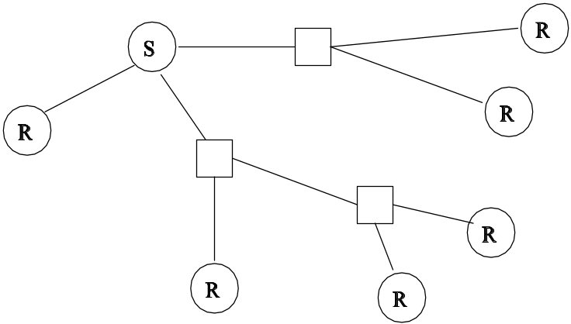
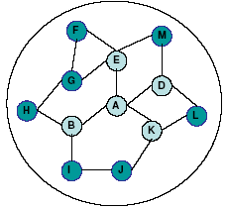
MAC for Multicast: a Challenging Issue
Multicast: efficient info delivery from a source to a set of destinations simultaneously
Uses 802.11 CSMA/CA
Cannot use RTS/CTS exchange
Currently there are no effective MAC protocols for multicast

